Slide 2

Digital Image Processing
Prepared by
K.Indragandhi,AP(Sr.Gr.)/ECE

Slide 3
Digital image processing
Basic Relationships between Pixels

Slide 4
Neighbors of a Pixel
f(0,0) f(0,1) f(0,2) f(0,3) f(0,4) - - - - -
f(1,0) f(1,1) f(1,2) f(1,3) f(1,4) - - - - -
f(x,y) = f(2,0) f(2,1) f(2,2) f(2,3) f(2,4) - - - - -
f(3,0) f(3,1) f(3,2) f(3,3) f(3,4) - - - - -
I I I I I - - - - -
I I I I I - - - - -

Slide 5
Neighbors of a Pixel
f(0,0) f(0,1) f(0,2) f(0,3) f(0,4) - - - - -
f(1,0) f(1,1) f(1,2) f(1,3) f(1,4) - - - - -
f(x,y) = f(2,0) f(2,1) f(2,2) f(2,3) f(2,4) - - - - -
f(3,0) f(3,1) f(3,2) f(3,3) f(3,4) - - - - -
I I I I I - - - - -
I I I I I - - - - -
A Pixel p at coordinates ( x, y) has 4 horizontal and vertical neighbors.
Their coordinates are given by:
(x+1, y) (x-1, y) (x, y+1) & (x, y-1)
f(2,1) f(0,1) f(1,2) f(1,0)
This set of pixels is called the 4-neighbors of p denoted by N₄(p).
Each pixel is unit distance from ( x ,y).

Slide 6
Neighbors of a Pixel
f(0,0) f(0,1) f(0,2) f(0,3) f(0,4) - - - - -
f(1,0) f(1,1) f(1,2) f(1,3) f(1,4) - - - - -
f(x,y) = f(2,0) f(2,1) f(2,2) f(2,3) f(2,4) - - - - -
f(3,0) f(3,1) f(3,2) f(3,3) f(3,4) - - - - -
I I I I I - - - - -
I I I I I - - - - -
A Pixel p at coordinates ( x, y) has 4 diagonal neighbors.
Their coordinates are given by:
(x+1, y+1) (x+1, y-1) (x-1, y+1) & (x-1, y-1)
f(2,2) f(2,0) f(0,2) f(0,0)
This set of pixels is called the diagonal-neighbors of p denoted by N_{D}(p).
diagonal neighbors + 4-neighbors = 8-neighbors of p.
They are denoted by N₈(p). So, N₈(p) = N₄(p) + N_{D}(p)

Slide 7
Adjacency, Connectivity
Adjacency: Two pixels are adjacent if they are neighbors and their intensity level ‘V’ satisfy some specific criteria of similarity.
e.g. V = {1}
V = { 0, 2}
Binary image = { 0, 1}
Gray scale image = { 0, 1, 2, ------, 255}
In binary images, 2 pixels are adjacent if they are neighbors & have some intensity values either 0 or 1.
In gray scale, image contains more gray level values in range 0 to 255.

Slide 8
Adjacency, Connectivity
4-adjacency: Two pixels p and q with the values from set ‘V’ are 4-adjacent if q is in the set of N₄(p).
e.g. V = { 0, 1}
1 1 2
1 1 0
1 0 1
p in RED color
q can be any value in green color.

Slide 9
Adjacency, Connectivity
8-adjacency: Two pixels p and q with the values from set ‘V’ are 8-adjacent if q is in the set of N₈(p).
e.g. V = { 1, 2}
0 1 1
0 2 0
0 0 1
p in RED color
q can be any value in green color

Slide 10
Adjacency, Connectivity
m-adjacency: Two pixels p and q with the values from set ‘V’ are m-adjacent if
q is in N₄(p) OR
q is in N_{D}(p) & the set N₄(p) n N₄(q) have no pixels whose values are from ‘V’.
e.g. V = { 1 }
0 a 1 b 1 c
0 d 1 e 0 f
0 g 0 h 1 i

Slide 11
Adjacency, Connectivity
m-adjacency: Two pixels p and q with the values from set ‘V’ are m-adjacent if
q is in N₄(p)
e.g. V = { 1 }
(i) b & c
0 a 1 b 1 c
0 d 1 e 0 f
0 g 0 h 1 I

Slide 12
Adjacency, Connectivity
m-adjacency: Two pixels p and q with the values from set ‘V’ are m-adjacent if
q is in N₄(p)
e.g. V = { 1 }
(i) b & c
0 a 1 b 1 c
0 d 1 e 0 f
0 g 0 h 1 I
Soln: b & c are m-adjacent.

Slide 13
Adjacency, Connectivity
m-adjacency: Two pixels p and q with the values from set ‘V’ are m-adjacent if
q is in N₄(p)
e.g. V = { 1 }
(ii) b & e
0 a 1 b 1 c
0 d 1 e 0 f
0 g 0 h 1 I

Slide 14
Adjacency, Connectivity
m-adjacency: Two pixels p and q with the values from set ‘V’ are m-adjacent if
q is in N₄(p)
e.g. V = { 1 }
(ii) b & e
0 a 1 b 1 c
0 d 1 e 0 f
0 g 0 h 1 I
Soln: b & e are m-adjacent.

Slide 15
Adjacency, Connectivity
m-adjacency: Two pixels p and q with the values from set ‘V’ are m-adjacent if
q is in N₄(p) OR
e.g. V = { 1 }
(iii) e & i
0 a 1 b 1 c
0 d 1 e 0 f
0 g 0 h 1 i

Slide 16
Adjacency, Connectivity
m-adjacency: Two pixels p and q with the values from set ‘V’ are m-adjacent if
q is in N_{D}(p) & the set N₄(p) n N₄(q) have no pixels whose values are from ‘V’.
e.g. V = { 1 }
(iii) e & i
0 a 1 b 1 c
0 d 1 e 0 f
0 g 0 h 1 I

Slide 17
Adjacency, Connectivity
m-adjacency: Two pixels p and q with the values from set ‘V’ are m-adjacent if
q is in N_{D}(p) & the set N₄(p) n N₄(q) have no pixels whose values are from ‘V’.
e.g. V = { 1 }
(iii) e & i
0 a 1 b 1 c
0 d 1 e 0 f
0 g 0 h 1 I
Soln: e & i are m-adjacent.

Slide 18
Adjacency, Connectivity
m-adjacency: Two pixels p and q with the values from set ‘V’ are m-adjacent if
q is in N₄(p) OR
q is in N_{D}(p) & the set N₄(p) n N₄(q) have no pixels whose values are from ‘V’.
e.g. V = { 1 }
(iv) e & c
0 a 1 b 1 c
0 d 1 e 0 f
0 g 0 h 1 I

Slide 19
Adjacency, Connectivity
m-adjacency: Two pixels p and q with the values from set ‘V’ are m-adjacent if
q is in N₄(p) OR
q is in N_{D}(p) & the set N₄(p) n N₄(q) have no pixels whose values are from ‘V’.
e.g. V = { 1 }
(iv) e & c
0 a 1 b 1 c
0 d 1 e 0 f
0 g 0 h 1 I
Soln: e & c are NOT m-adjacent.

Slide 20
Adjacency, Connectivity
Connectivity: 2 pixels are said to be connected if their exists a path between them.
Let ‘S’ represent subset of pixels in an image.
Two pixels p & q are said to be connected in ‘S’ if their exists a path between them consisting entirely of pixels in ‘S’.
For any pixel p in S, the set of pixels that are connected to it in S is called a connected component of S.

Slide 21
Paths
Paths: A path from pixel p with coordinate ( x, y) with pixel q with coordinate ( s, t) is a sequence of distinct sequence with coordinates (x₀, y₀), (x₁, y₁), ….., (x_{n}, y_{n}) where
(x, y) = (x₀, y₀)
& (s, t) = (x_{n}, y_{n})
Closed path: (x₀, y₀) = (x_{n}, y_{n})

Slide 22
Paths
Example # 1: Consider the image segment shown in figure. Compute length of the shortest-4, shortest-8 & shortest-m paths between pixels p & q where,
V = {1, 2}.
4 2 3 2 q
3 3 1 3
2 3 2 2
p 2 1 2 3

Slide 23
Paths
Example # 1:
Shortest-4 path:
V = {1, 2}.
4 2 3 2 q
3 3 1 3
2 3 2 2
p 2 1 2 3

Slide 24
Paths
Example # 1:
Shortest-4 path:
V = {1, 2}.
4 2 3 2 q
3 3 1 3
2 3 2 2
p 2 1 2 3

Slide 25
Paths
Example # 1:
Shortest-4 path:
V = {1, 2}.
4 2 3 2 q
3 3 1 3
2 3 2 2
p 2 1 2 3

Slide 26
Paths
Example # 1:
Shortest-4 path:
V = {1, 2}.
4 2 3 2 q
3 3 1 3
2 3 2 2
p 2 1 2 3

Slide 27
Paths
Example # 1:
Shortest-4 path:
V = {1, 2}.
4 2 3 2 q
3 3 1 3
2 3 2 2
p 2 1 2 3

Slide 28
Paths
Example # 1:
Shortest-4 path:
V = {1, 2}.
4 2 3 2 q
3 3 1 3
2 3 2 2
p 2 1 2 3
So, Path does not exist.

Slide 29
Paths
Example # 1:
Shortest-8 path:
V = {1, 2}.
4 2 3 2 q
3 3 1 3
2 3 2 2
p 2 1 2 3

Slide 30
Paths
Example # 1:
Shortest-8 path:
V = {1, 2}.
4 2 3 2 q
3 3 1 3
2 3 2 2
p 2 1 2 3

Slide 31
Paths
Example # 1:
Shortest-8 path:
V = {1, 2}.
4 2 3 2 q
3 3 1 3
2 3 2 2
p 2 1 2 3

Slide 32
Paths
Example # 1:
Shortest-8 path:
V = {1, 2}.
4 2 3 2 q
3 3 1 3
2 3 2 2
p 2 1 2 3

Slide 33
Paths
Example # 1:
Shortest-8 path:
V = {1, 2}.
4 2 3 2 q
3 3 1 3
2 3 2 2
p 2 1 2 3

Slide 34
Paths
Example # 1:
Shortest-8 path:
V = {1, 2}.
4 2 3 2 q
3 3 1 3
2 3 2 2
p 2 1 2 3
So, shortest-8 path = 4

Slide 35
Paths
Example # 1:
Shortest-m path:
V = {1, 2}.
4 2 3 2 q
3 3 1 3
2 3 2 2
p 2 1 2 3

Slide 36
Paths
Example # 1:
Shortest-m path:
V = {1, 2}.
4 2 3 2 q
3 3 1 3
2 3 2 2
p 2 1 2 3

Slide 37
Paths
Example # 1:
Shortest-m path:
V = {1, 2}.
4 2 3 2 q
3 3 1 3
2 3 2 2
p 2 1 2 3

Slide 38
Paths
Example # 1:
Shortest-m path:
V = {1, 2}.
4 2 3 2 q
3 3 1 3
2 3 2 2
p 2 1 2 3

Slide 39
Paths
Example # 1:
Shortest-m path:
V = {1, 2}.
4 2 3 2 q
3 3 1 3
2 3 2 2
p 2 1 2 3

Slide 40
Paths
Example # 1:
Shortest-m path:
V = {1, 2}.
4 2 3 2 q
3 3 1 3
2 3 2 2
p 2 1 2 3

Slide 41
Paths
Example # 1:
Shortest-m path:
V = {1, 2}.
4 2 3 2 q
3 3 1 3
2 3 2 2
p 2 1 2 3
So, shortest-m path = 5

Slide 42
Regions & Boundaries
Region: Let R be a subset of pixels in an image. Two regions Ri and Rj are said to be adjacent if their union form a connected set.
Regions that are not adjacent are said to be disjoint.
We consider 4- and 8- adjacency when referring to regions.
Below regions are adjacent only if 8-adjacency is used.
1 1 1
1 0 1 R_{i}
0 1 0
0 0 1
1 1 1 R_{j}
1 1 1

Slide 43
Regions & Boundaries
Boundaries (border or contour): The boundary of a region R is the set of points that are adjacent to points in the compliment of R.
0 0 0 0 0
0 1 1 0 0
0 1 1 0 0
0 1 1 1 0
0 1 1 1 0
0 0 0 0 0
RED colored 1 is not a member of border if 4-connectivity is used between region and background. It is if 8-connectivity is used.

Slide 44

Example:

Slide 45


Slide 46


Slide 47


Slide 48


Slide 49


Slide 50


Slide 51
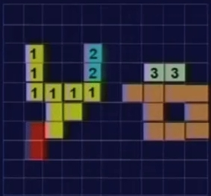
(1=2)

Slide 52


Slide 53
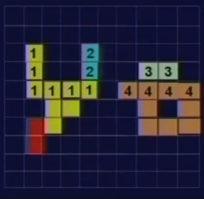
(3=4)

Slide 54


Slide 55
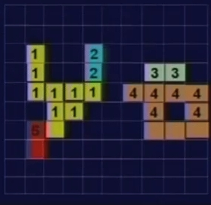

Slide 56

(1=5)

Slide 57
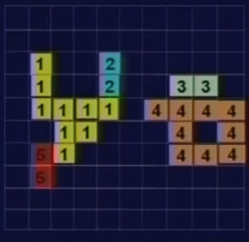

Slide 58
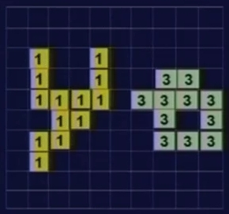

Slide 59
Distance Measures
Distance Measures: Distance between pixels p, q & z with co-ordinates ( x, y), ( s, t) & ( v, w) resp. is given by:
D( p, q) ≥ 0 [ D( p, q) = 0 if p = q] …………..called reflexivity
D( p, q) = D( q, p) .………….called symmetry
D( p, z) ≤ D( p, q) + D( q, z) ..………….called transmitivity
Euclidean distance between p & q is defined as-
D_{e}( p, q) = [( x- s)² + (y - t)²]^{1/2}

Slide 60
Distance Measures
City Block Distance: The D₄ distance between p & q is defined as
D₄( p, q) = |x - s| + |y - t|
In this case, pixels having D₄ distance from ( x, y) less than or equal to some value r form a diamond centered at ( x, y).
2
2 1 2
2 1 0 1 2
2 1 2
2
Pixels with D₄ distance ≤ 2 forms the following contour of constant distance.

Slide 61
Distance Measures
Chess-Board Distance: The D₈ distance between p & q is defined as
D₈( p, q) = max( |x - s| , |y - t| )
In this case, pixels having D₈ distance from ( x, y) less than or equal to some value r form a square centered at ( x, y).
2 2 2 2 2
2 1 1 1 2
2 1 0 1 2
2 1 1 1 2
2 2 2 2 2
Pixels with D₈ distance ≤ 2 forms the following contour of constant distance.

Slide 62
Set operations

Slide 63
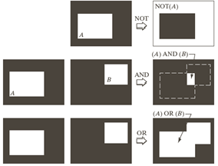
Logical operations

Slide 64
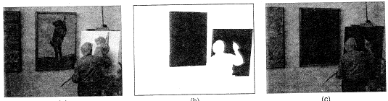
The AND operator is usually used to mask out part of an image.

Slide 65
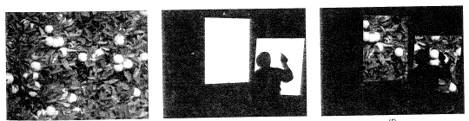
Parts of another image can be added with a logical OR operator.

Slide 66
Result of AND
Result of OR
OR

Slide 67


